Slide 1

Introduction to Bioengineering Theory
(BBL1020; 3-0-0)
Genome
Mutations

Slide 2
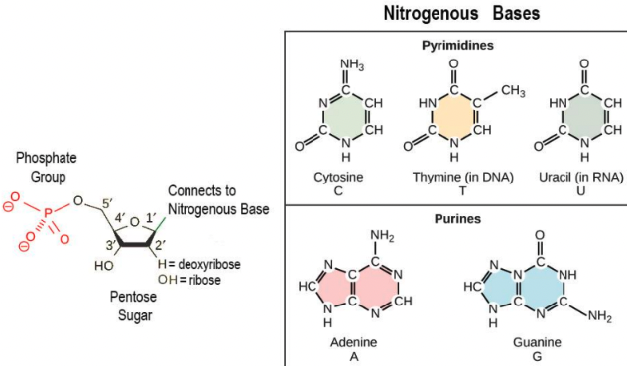
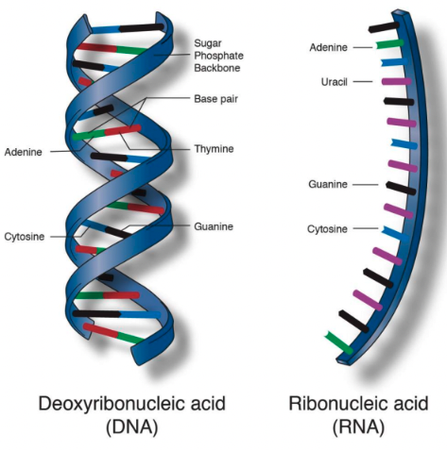
Bio-macromolecules: DNA- Building block of life

Slide 3
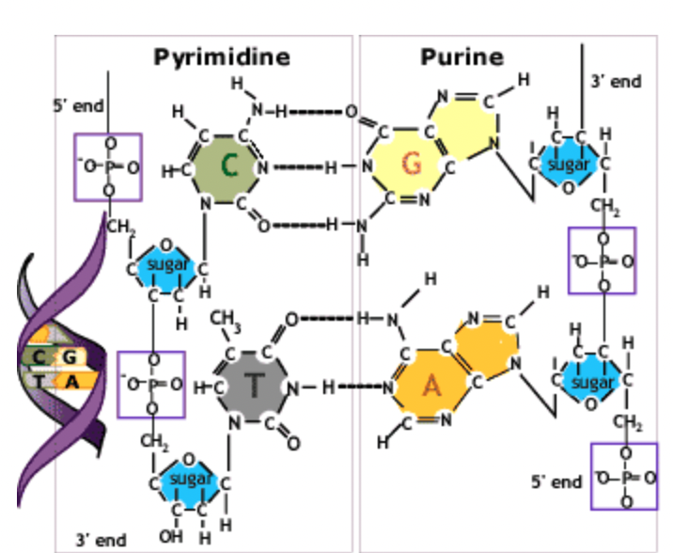
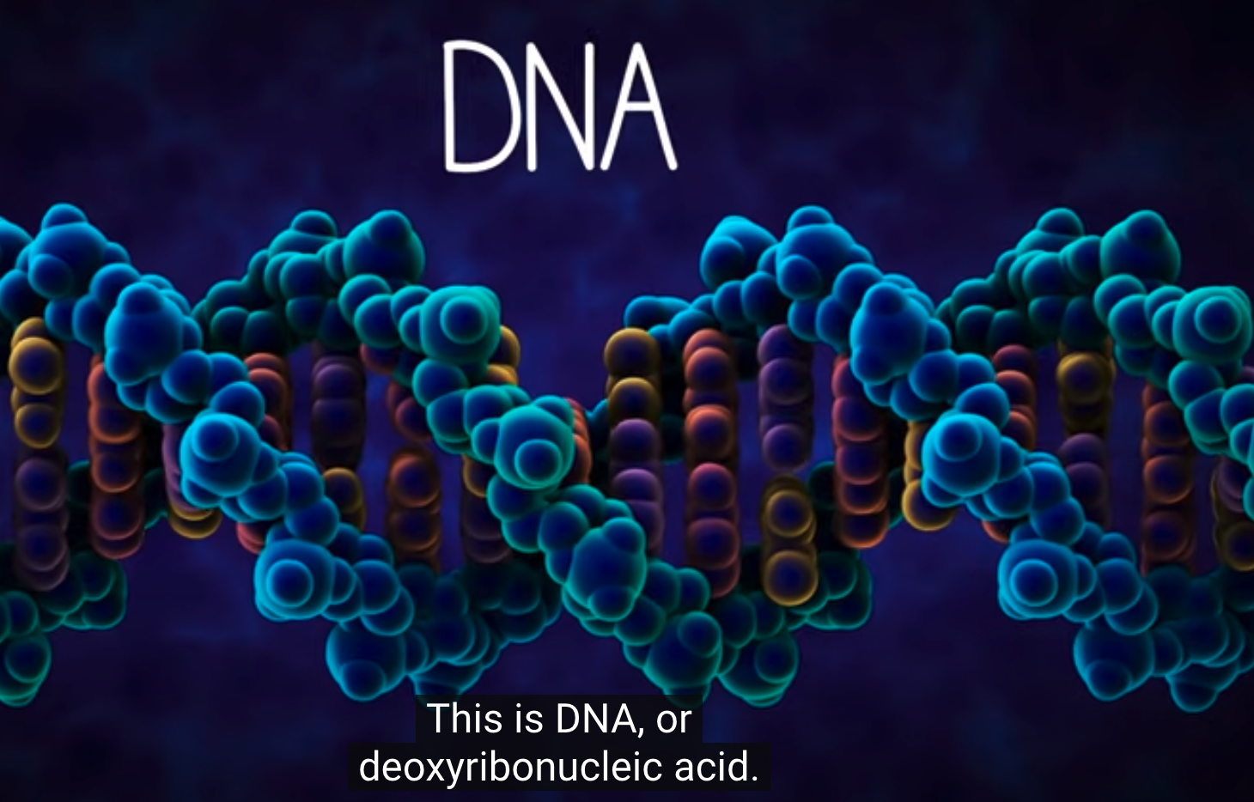
Bio-macromolecules: DNA- Building block of life
The Structure of DNA
The building blocks of DNA are the 5-carbon sugar deoxyribose linked together by phosphodiester bonds forming two strands of sugar-phosphate backbones on the outside of the double helix.
Each ribose binds one of four alternative bases: adenine (A), guanine (G), cytosine (C) or thymine (T).
The opposing strands are held together by base pairing between the two strands: G is always paired with C by three hydrogen bonds and A is always paired with T by two hydrogen bonds.
https://youtu.be/o_-6JXLYS-k?si=WlJeegTfEUJIR1Zp
Notes:
The building blocks of DNA are the 5-carbon sugar deoxyribose linked together by phosphodiester bonds forming two strands of sugar-phosphate backbones on the outside of the double helix. Each ribose also binds one of four alternative bases: adenine (A), guanine (G), cytosine (C) or thymine (T).The opposing strands are held together by basepairing between the two strands: G is always paired with C by three hydrogen bonds and A is always paired with T by two hydrogen bonds.

Slide 4
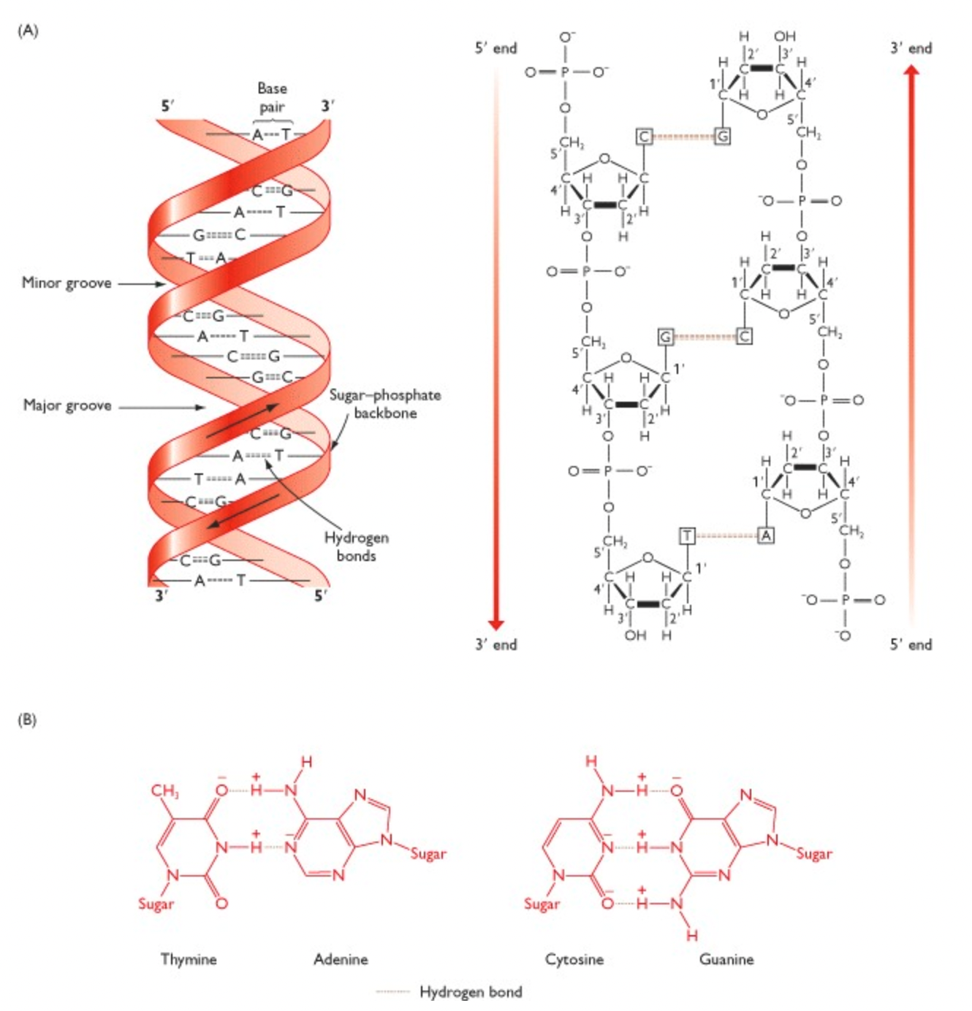
Bio-macromolecules: DNA- Building block of life
The Structure of DNA
The building blocks of DNA are the 5-carbon sugar deoxyribose linked together by phosphodiester bonds forming two strands of sugar-phosphate backbones on the outside of the double helix.
Each ribose binds one of four alternative bases: adenine (A), guanine (G), cytosine (C) or thymine (T).
The opposing strands are held together by base pairing between the two strands: G is always paired with C by three hydrogen bonds and A is always paired with T by two hydrogen bonds.
https://youtu.be/o_-6JXLYS-k?si=WlJeegTfEUJIR1Zp
Notes:
The building blocks of DNA are the 5-carbon sugar deoxyribose linked together by phosphodiester bonds forming two strands of sugar-phosphate backbones on the outside of the double helix. Each ribose also binds one of four alternative bases: adenine (A), guanine (G), cytosine (C) or thymine (T).The opposing strands are held together by basepairing between the two strands: G is always paired with C by three hydrogen bonds and A is always paired with T by two hydrogen bonds.

Slide 5
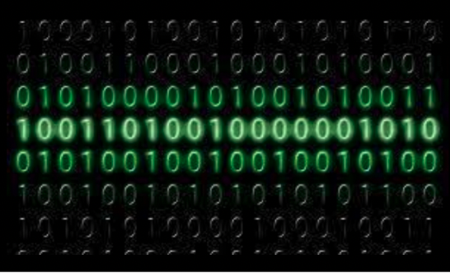
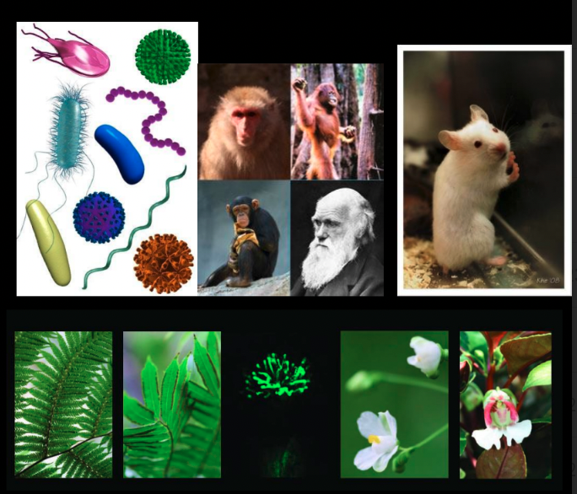
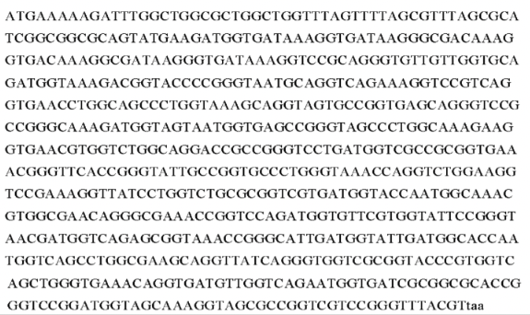
Bio-macromolecules: Code- Computer or DNA

Slide 6
Bio-macromolecules: Code- Computer or DNA
The genetic functions of DNA can thus be understood as the synergism of two
properties –
[1] a tape containing the information store encoding the sequences of RNA & proteins molecules
[2] polymer existing as double-helical string enabling the packaging, accessibility and replication of the information store.
Crucially, both the coding of proteins and RNA molecules and also the physicochemical properties of the polymer are specified by the base sequence.
In genomes, DNA molecules are generally very long, thin polymers with a diameter of 2 nm and a length that can extend to 10⁹ nm. As an information store, not only must DNA be able to encode the genetic information required to specify proteins, but also it should be packaged in a compact form that allows the accessibility of that information to be regulated.

Slide 7
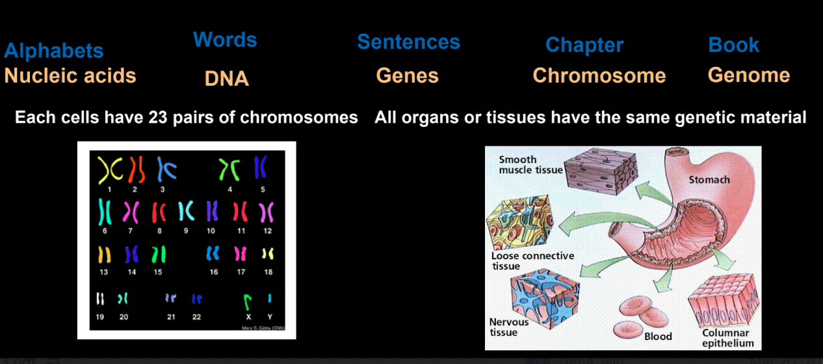
Genome: The Book of Life

Slide 8
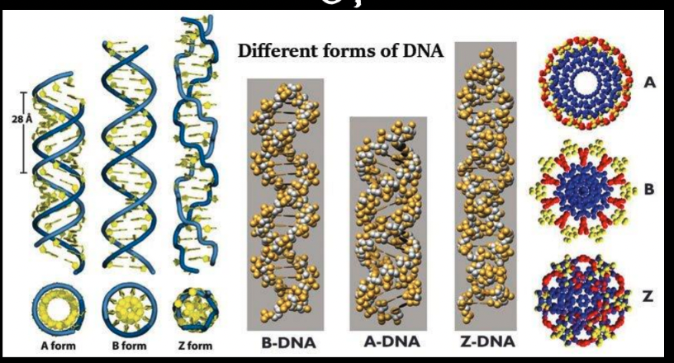
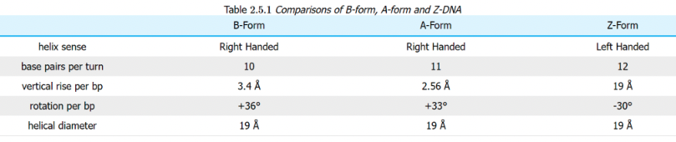
Types of DNA

Slide 9
Conditions Favoring A-form, B-form, and Z-form of DNA
1. The ionic or hydration environment, which can facilitate conversion between different helical forms.
Eg. A-DNA: favored by low hydration
Z-DNA: favored by high salt.
2. DNA sequence:
•A-DNA is favored by certain stretches of purines (or pyrimidines)
•Z-DNA can be most readily formed by alternating purine-pyrimidine steps.
3. Presence of proteins that can bind to DNA in one helical conformation and force the DNA to adopt a different conformation, such as proteins which bind to B-DNA and can drive it to either A-or Z forms.
In living cells, most of the DNA is in a mixture of A and B-DNA conformations, with a few small regions capable of forming Z-DNA.

Slide 10
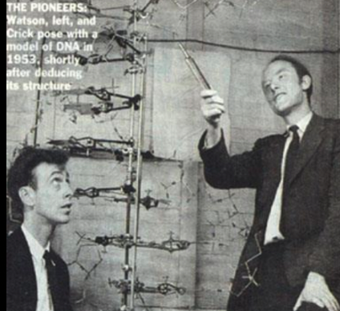
Brief history behind the discovery of DNA
Many people believe that James Watson and Francis
Crick discovered DNA in the 1950s. In reality, this is not
the case.
Rather, DNA was first identified in the late 1860s by
Swiss chemist Friedrich Miescher.
Then, in the decades following Miescher's discovery, other scientists--notably, Phoebus Levene and Erwin Chargaff--carried out a series of research efforts that revealed additional details about the DNA molecule, including its primary chemical components and the ways in which they joined with one another.
Further, Rosalind Elsie Franklin (British chemist and X-ray crystallographer) got the X-ray diffraction images of DNA
Without the scientific foundation provided by these pioneers, Watson and Crick may never have reached their groundbreaking conclusion of 1953: that the DNA molecule exists in the form of a three-dimensional double helix.
https://youtu.be/NGBDFq5Kaw0?si=t4ofs5MB_HSY6TDl

Slide 11
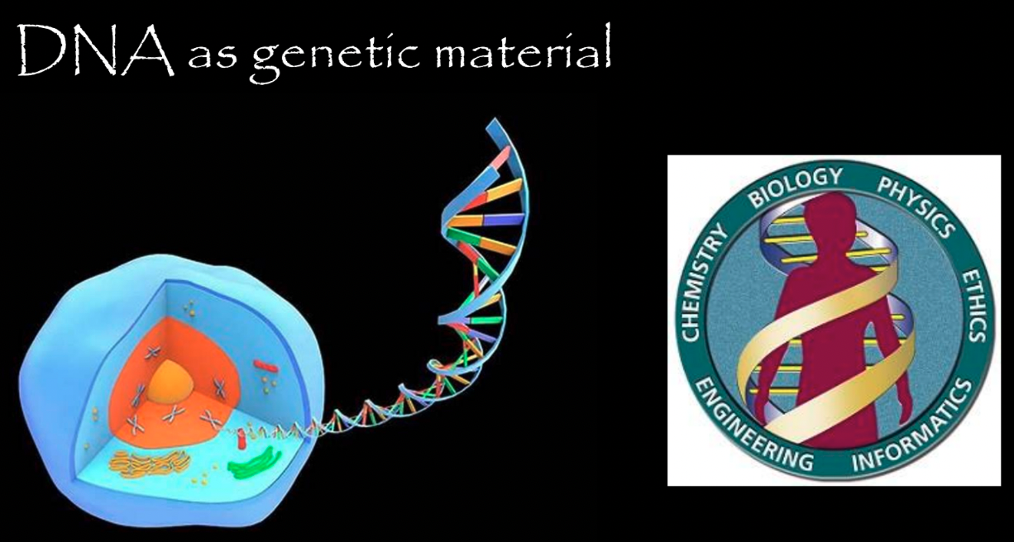
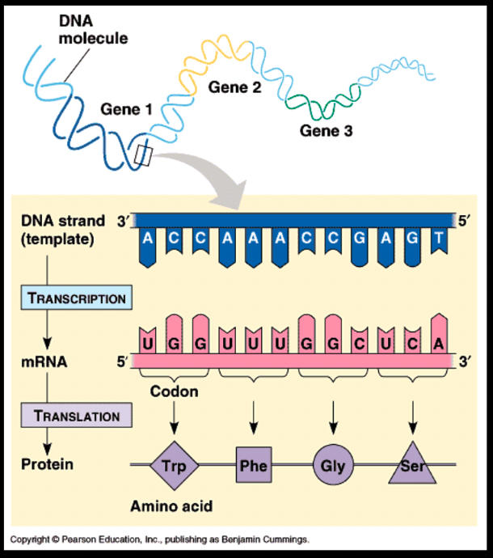
DNA as genetic material
Human: 30,000 genes (unique)
The nuclear genome comprises ~ 3 200 000 000 nucleotides of DNA
Notes:
Each cell of a human body has DNA which is 6 feet long and has around 3 billion base pairs and contains 30,000 genes. The average number of cells in the human body is around 10 trillion. Therefore, the length of the entire human DNA will be around 10 billion miles.

Slide 12
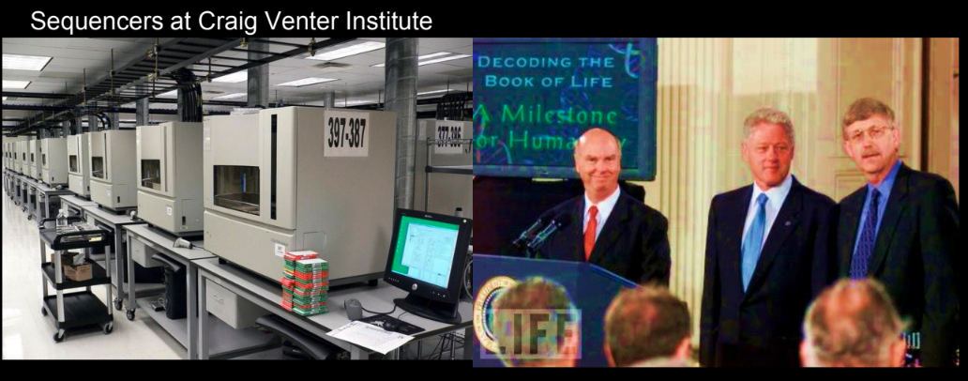
The human genome project
United States govt. through the National Institutes of Health (Publicly funded)
Celera Genomics, Craig Venter (Privately funded)
HGP Timeline
1990:
1996:
1998; 1999
2001:
2003:
Launched in
US
Human genome
map established
Incorporation of the 30K genes in human gene map;
chr 22 fully sequenced
Draft version of human genome published
Finished version of human genome published (92%)

Slide 13
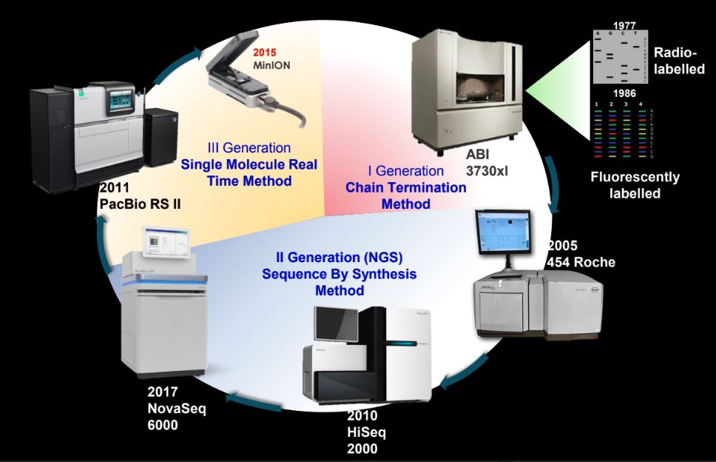
Evolution of sequencing technologies

Slide 14
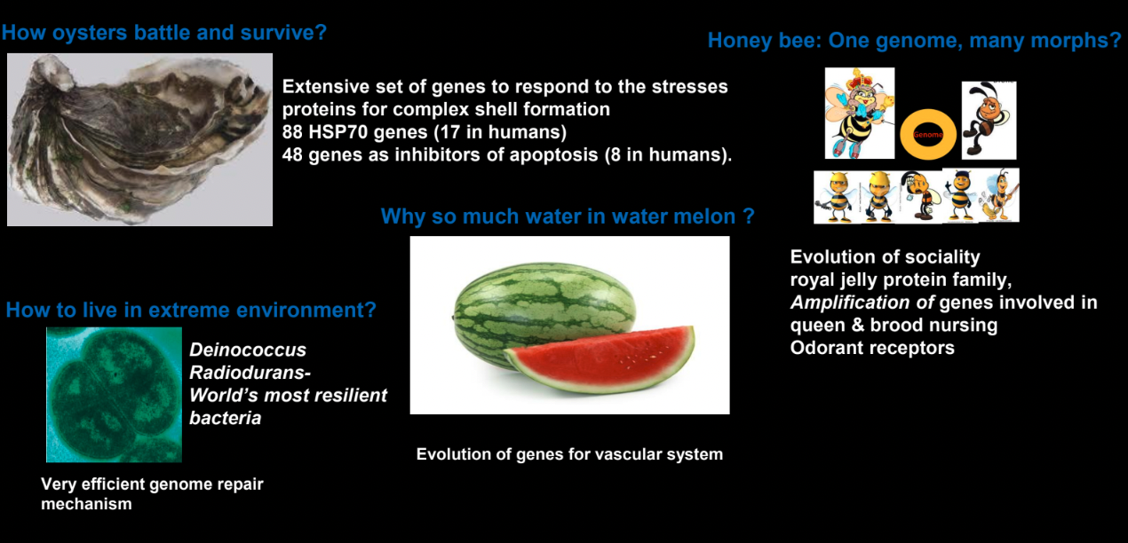
Each genome has a unique story!

Slide 15
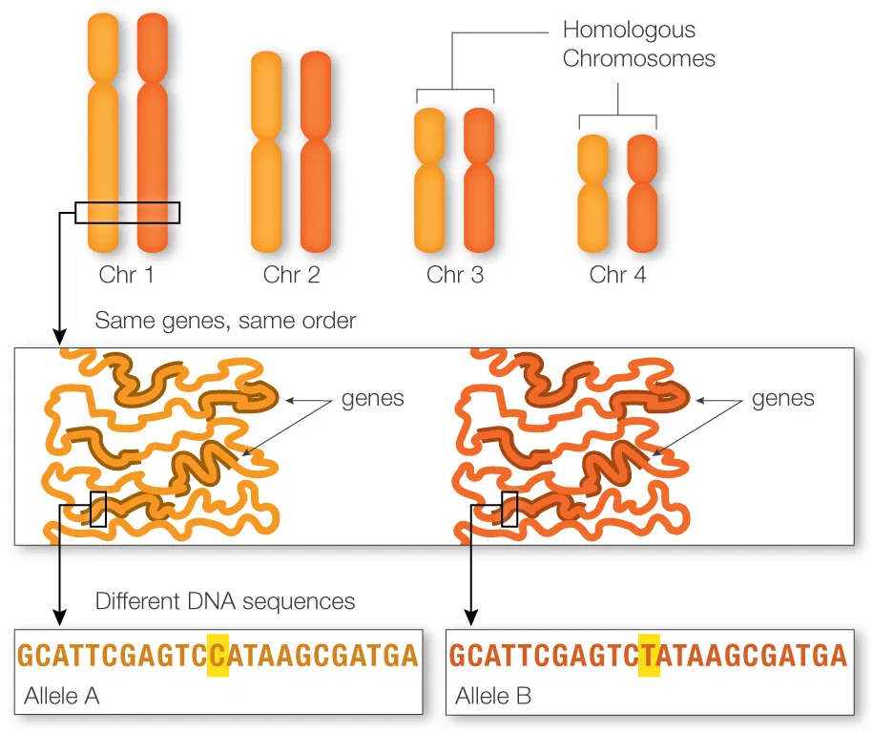

Slide 16
Genes get altered: Mutations
Missense
Substitution
Nonsense
silent
Indel: Insertion/ Deletion
Duplication
Repeat expansion

Slide 17
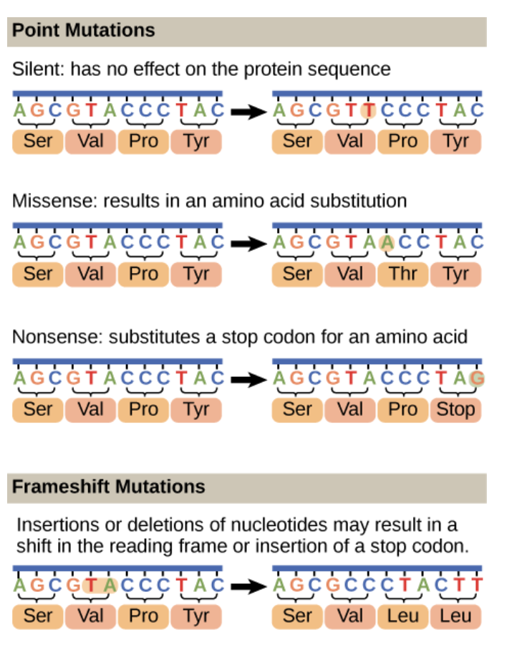
Genes get altered: Mutations
Substitution mutations
Indels mutations

Slide 18
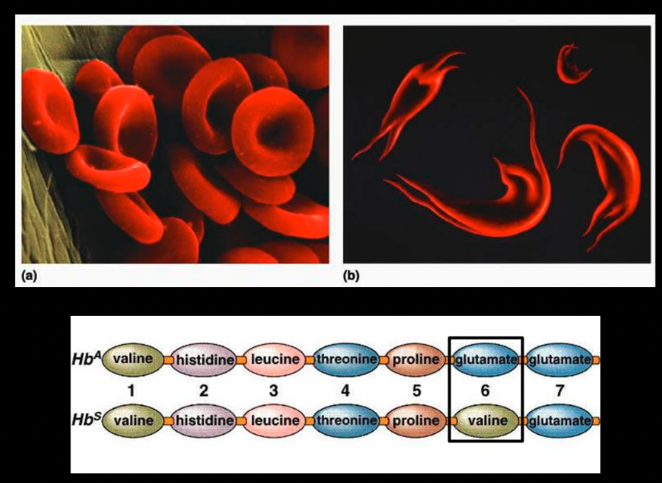
Why the change matter to us?

Slide 19
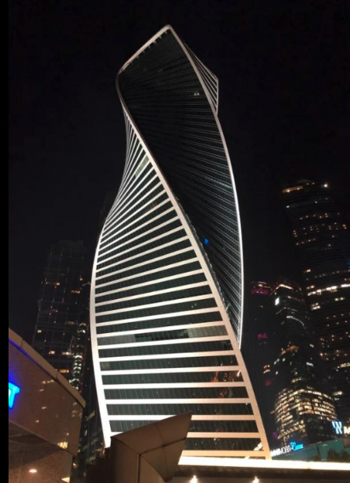
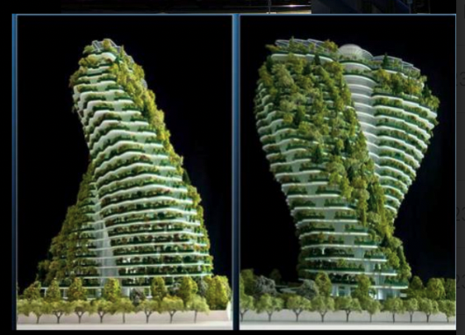
Bio-macromolecules: DNA- Learning from the structure
Residential building in Taipei, Taiwan
Evolution Tower, Moscow

Slide 20
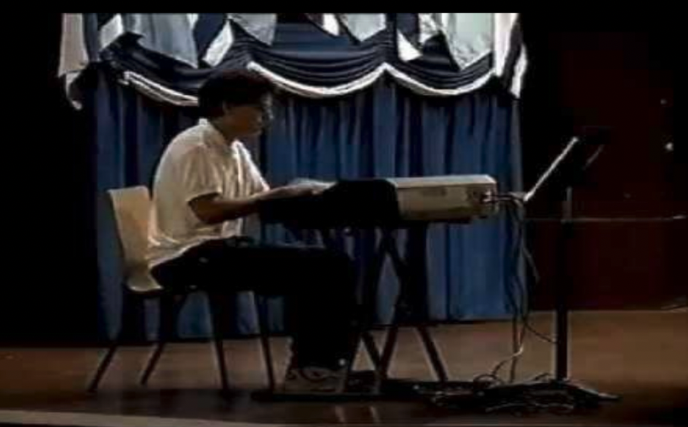
Have you heard DNA??
https://www.smithsonianmag.com/science-nature/why-scientists-are-turning-molecules-into-music-180980022/
https://www.youtube.com/watch?v=3nPK_O1dRmY
Notes:
Sc are turning molecules into music

Slide 21
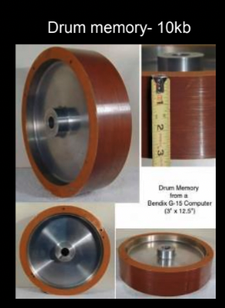
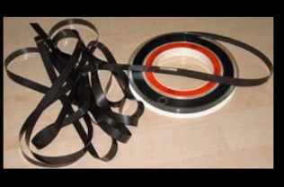
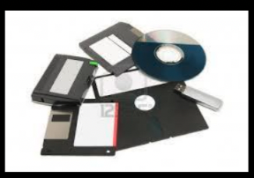
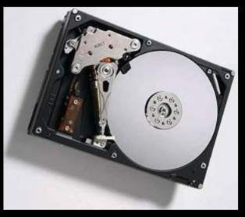
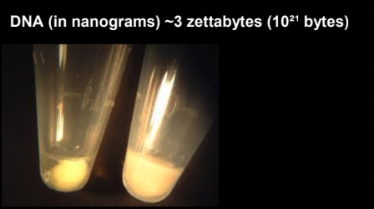
How to take care of large amount of digital information?

Slide 22
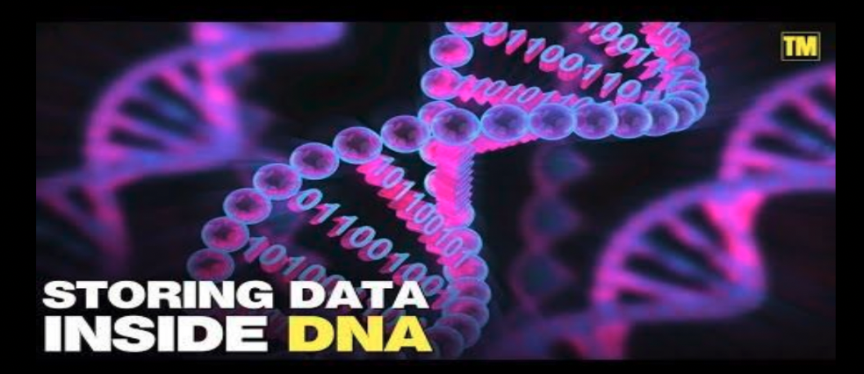
Science or Fiction
https://www.youtube.com/watch?v=Vky3h5_mFYY
After IoT ------DoT is the Science of tomorrow!!!

Slide 23
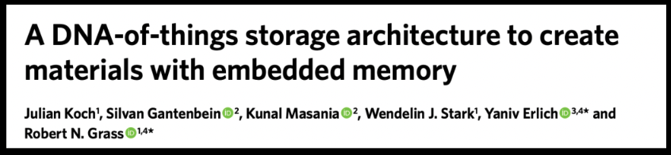
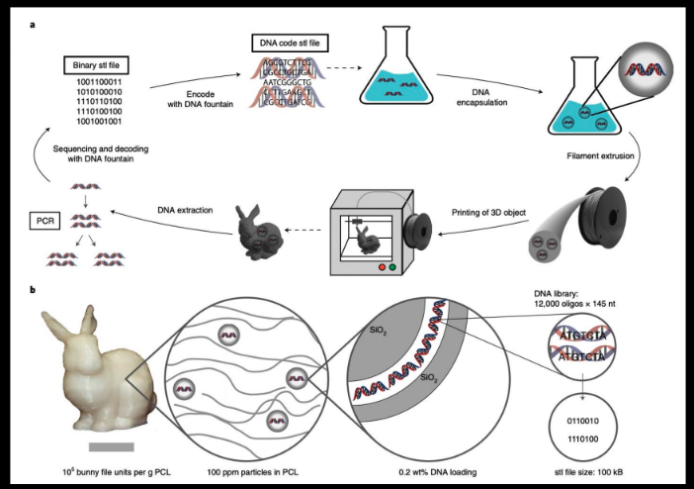
DNA of things – DoT
Nature Biotechnology volume 38, (2020)

Slide 24
Bibliography
Biochemistry: Voet, Voet, Pratt
Biology- A global Approach: Campbell
Genomes. 2nd edition., Chapter 1: The Human Genome

